Slide 1

VGA controller
By Vinay Garade

Slide 2
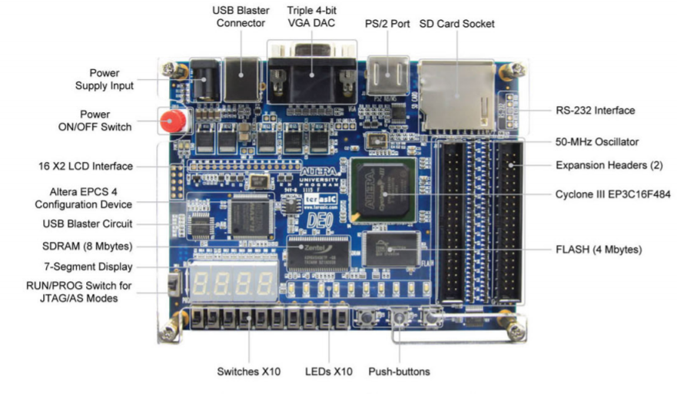
SOC
It is a complete embedded system on a single chip, including memory, microprocessor, I/O, FPGA
The board name is EP3C16484C6N

Slide 3
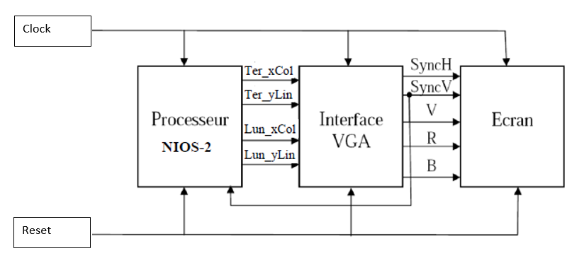
Design of the display system

Slide 4
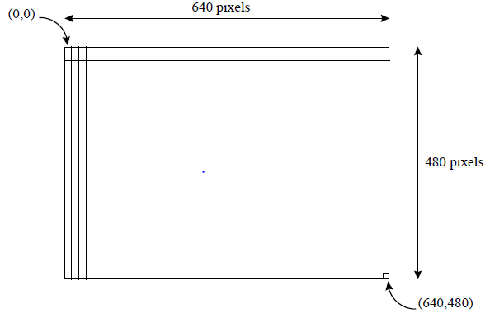
VGA Controller
the pixels of the image must be present at specific moments and accompanied by synchronization signals.
Each of pixels is coded in RGB. The image displayed by a VGA screen typically contains 640 columns and 480 rows.

Slide 5
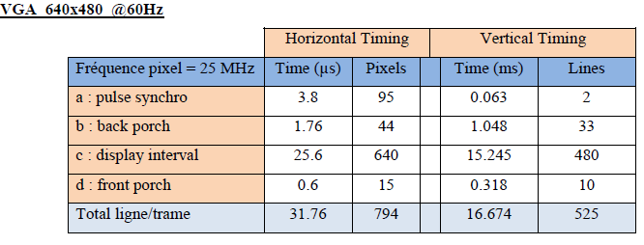
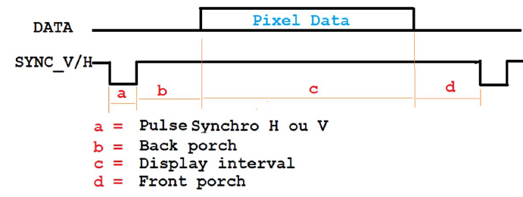
VGA Controller
1 pixel is 0.04 µs
Time for the whole Frame is 16.67 µs(800*525)

Slide 6
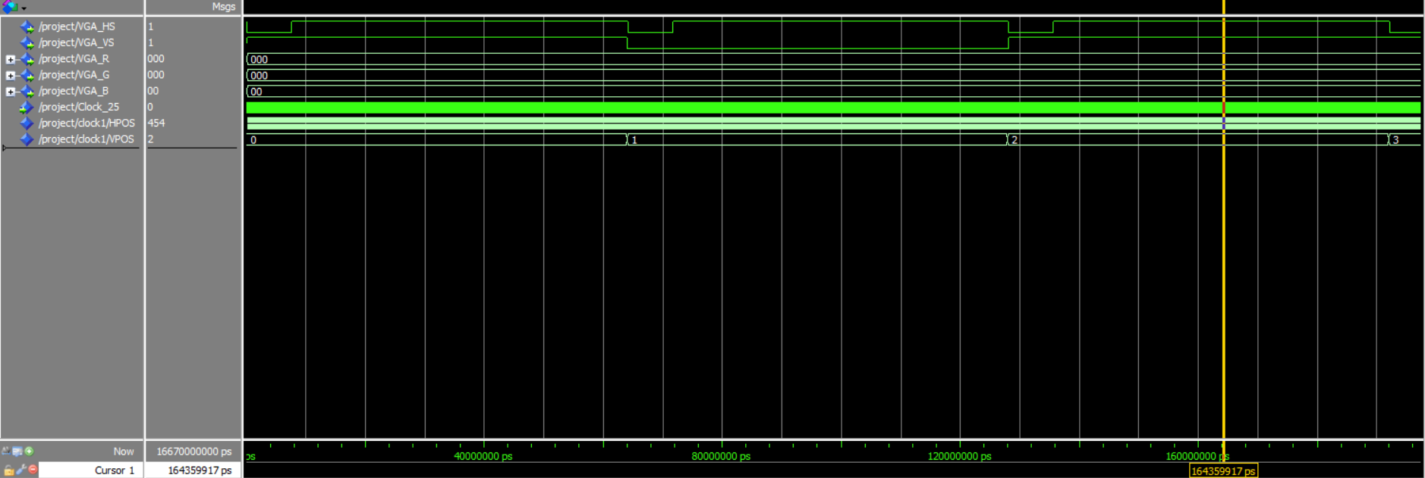
Result of VGA simulation for RGB strips
Vsync=1
HSYNC=1

Slide 7
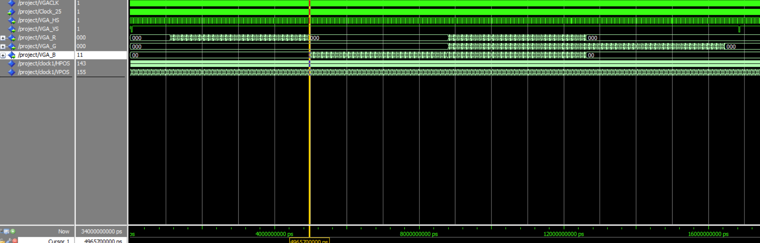
Result of VGA simulation for RGB strips
Red
Blue
White
Green

Slide 8
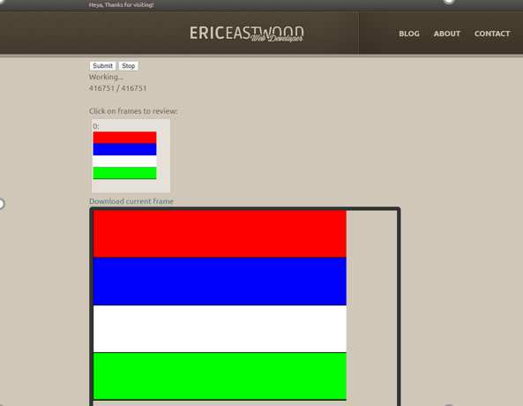
Online Simulation of VGA
The image is the simulation result of vga controller for displaying RBWG stripes on online simulator.
The LOG file of the VHDL code is generated using the Textio library
The log file is uploaded on the online simulator for simulating the result

Slide 9
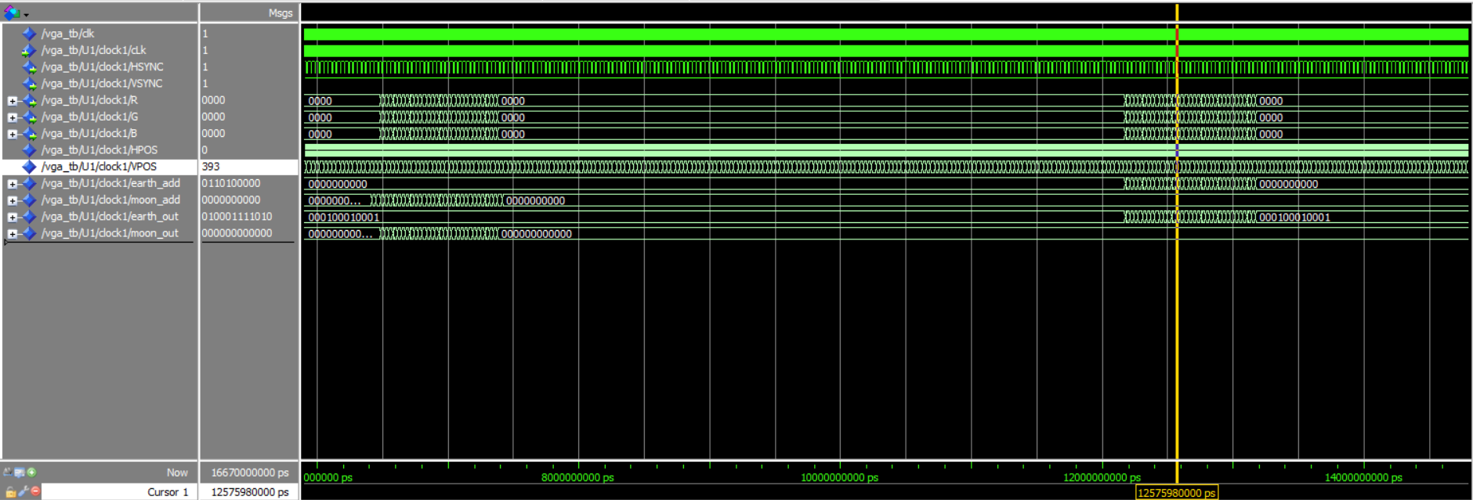
Result of VGA simulation for Earth and the moon
Moon image data output
Ccolor bits of RED, green , blue
Earth image data output

Slide 10
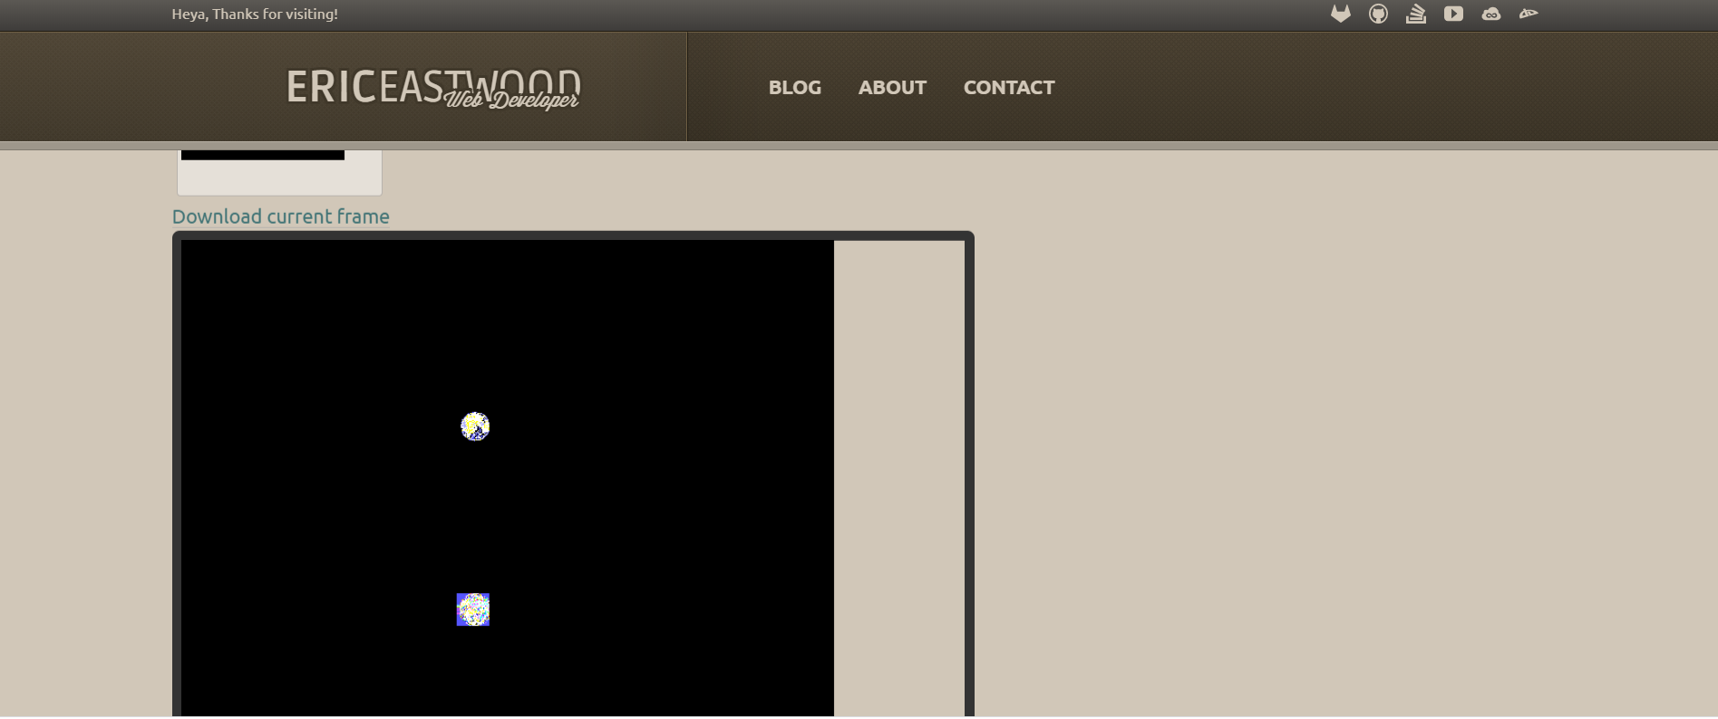
Online Simulation of Earth and Moon

Slide 11
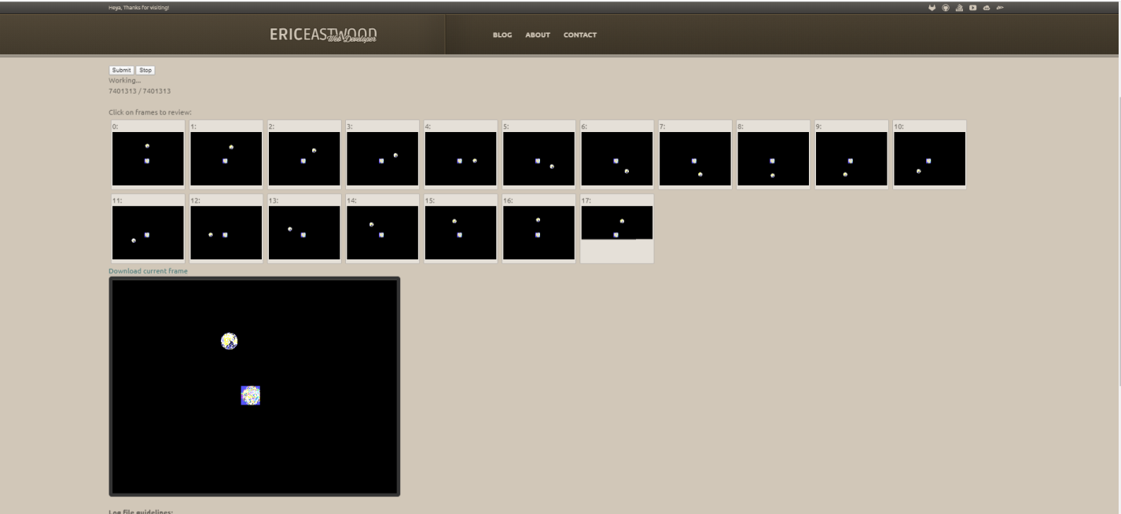
Online Simulation of Moon revolve around Earth

Slide 12
Problem we faced
Uploading the mif file on the Quartus ROM block
Creating LOG file for online simulation
Quartus PLL function couldn’t implement it on MODELSIM.

Slide 13
Thank you

